Slide 1
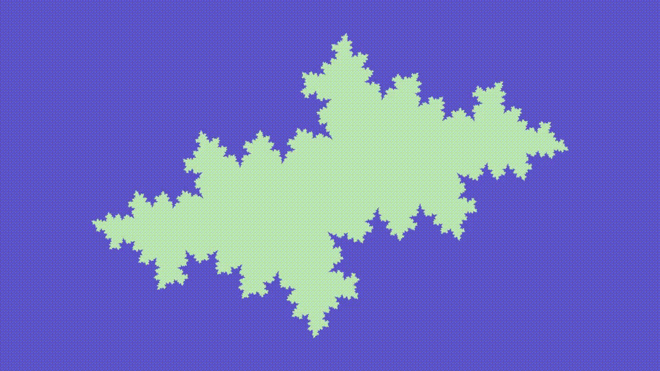
Image generation
with CUDA
Fractal computation
Shadow projection
Texture application

Slide 2
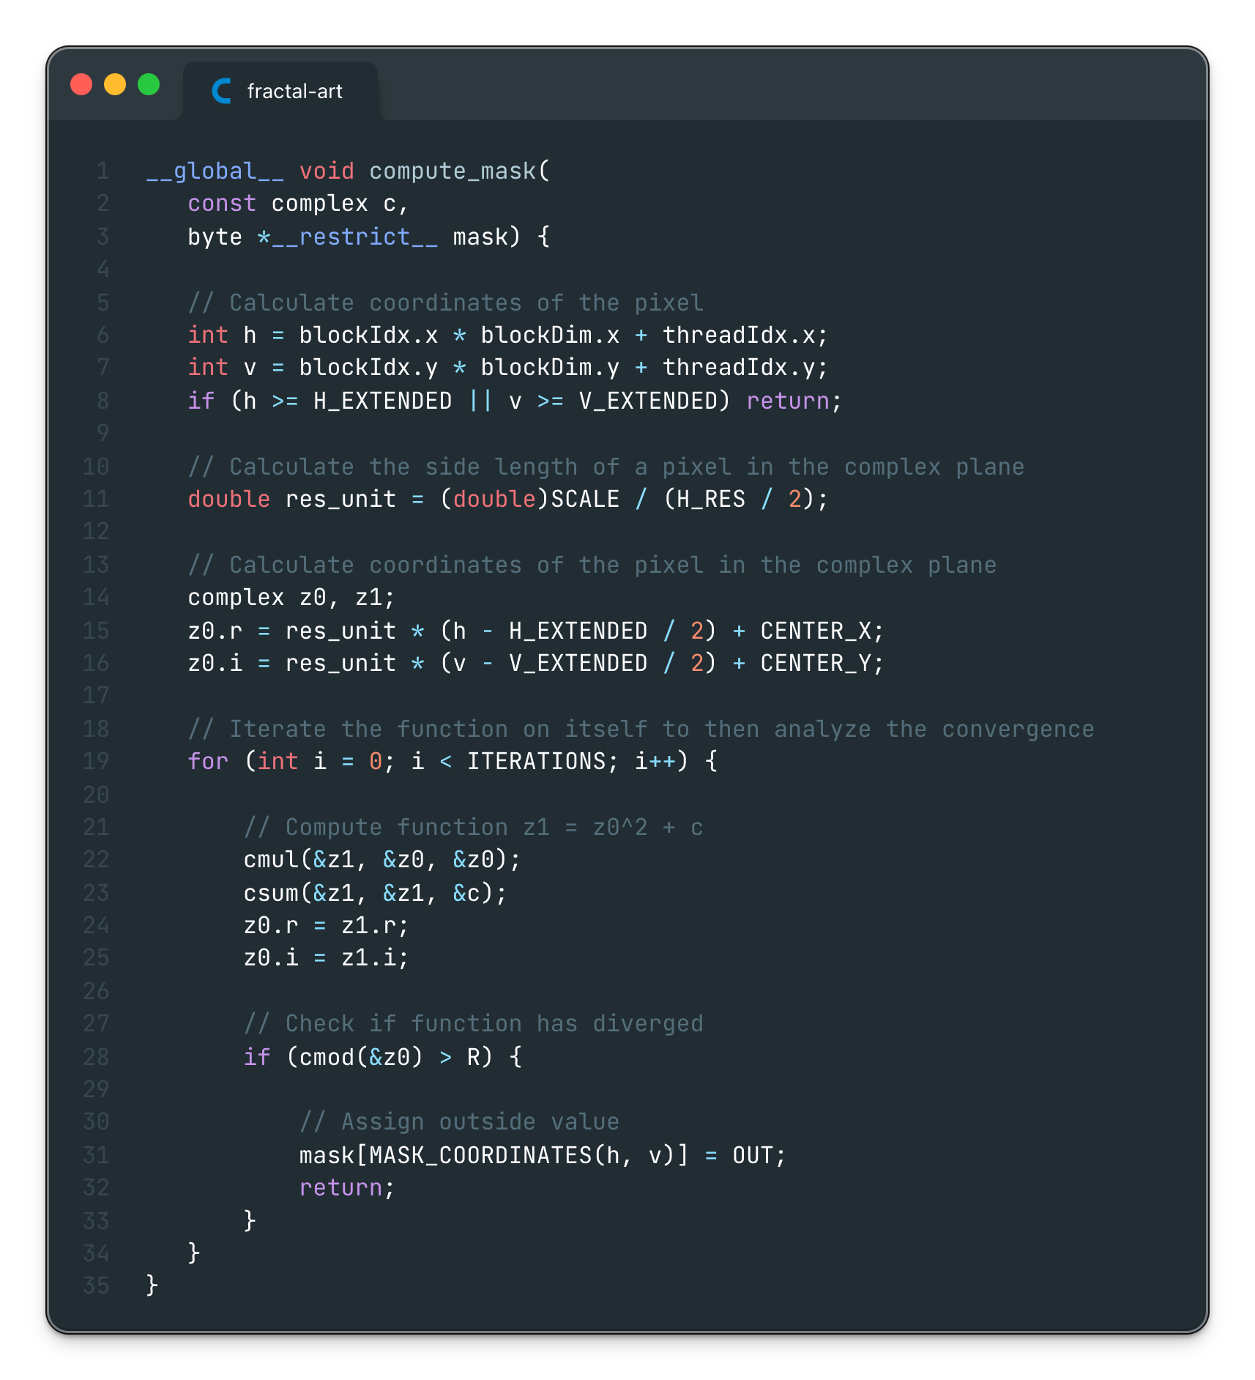
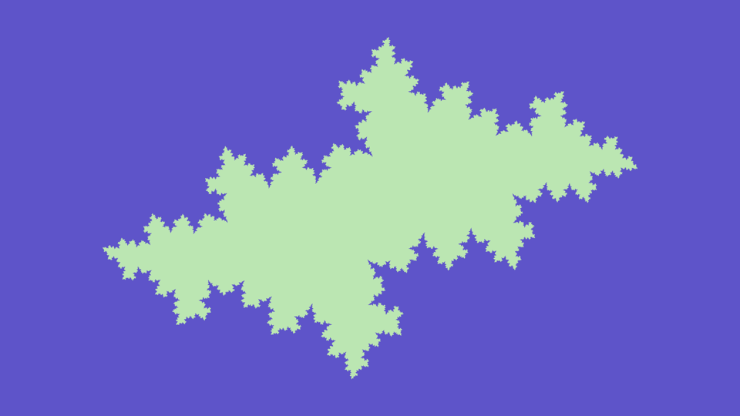
Fractal computation
A first image is generated by assigning different colors based on pixel behaviour when iterating a function (converge or diverge).

Slide 3
Fractal computation
Pixel coordinates calculations are based on the global thread ID (excluding outbounds).
Complex plane values are calculated starting from pixel coordinates.

Slide 4
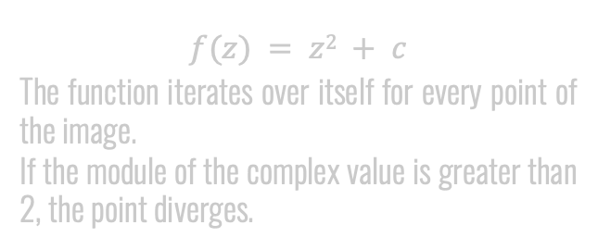
Fractal computation
$$f(z) = z2 + c$$
The function iterates over itself for every point of the image.
If the module of the complex value is greater than 2, the point diverges.

Slide 5
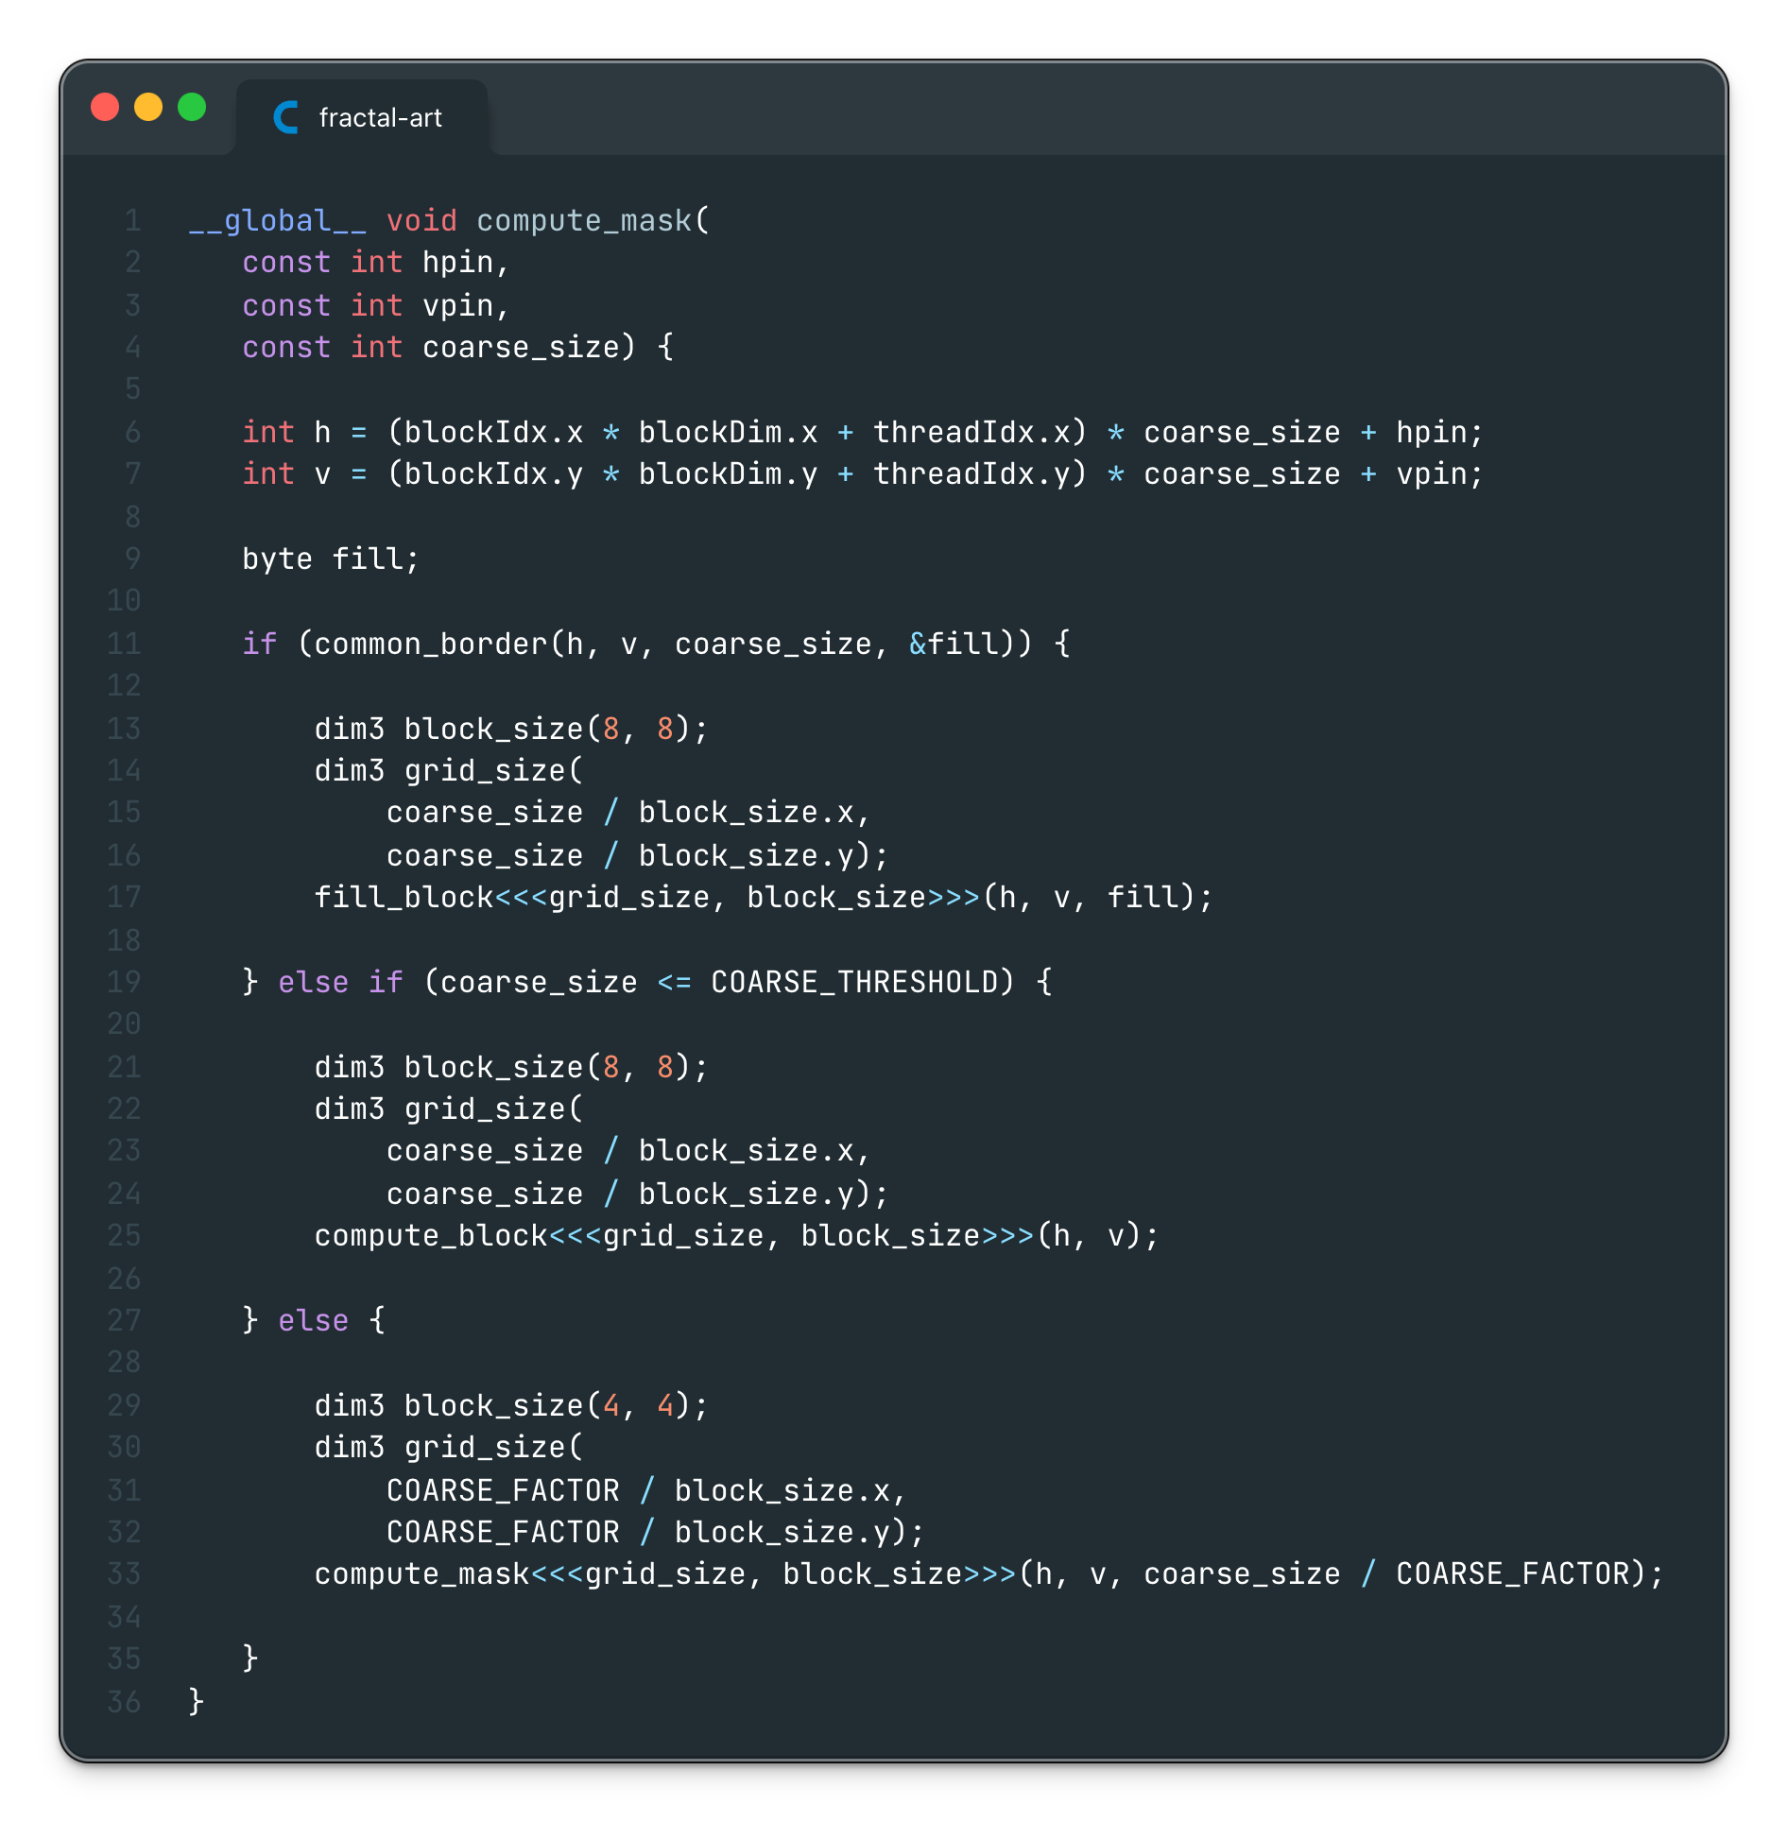
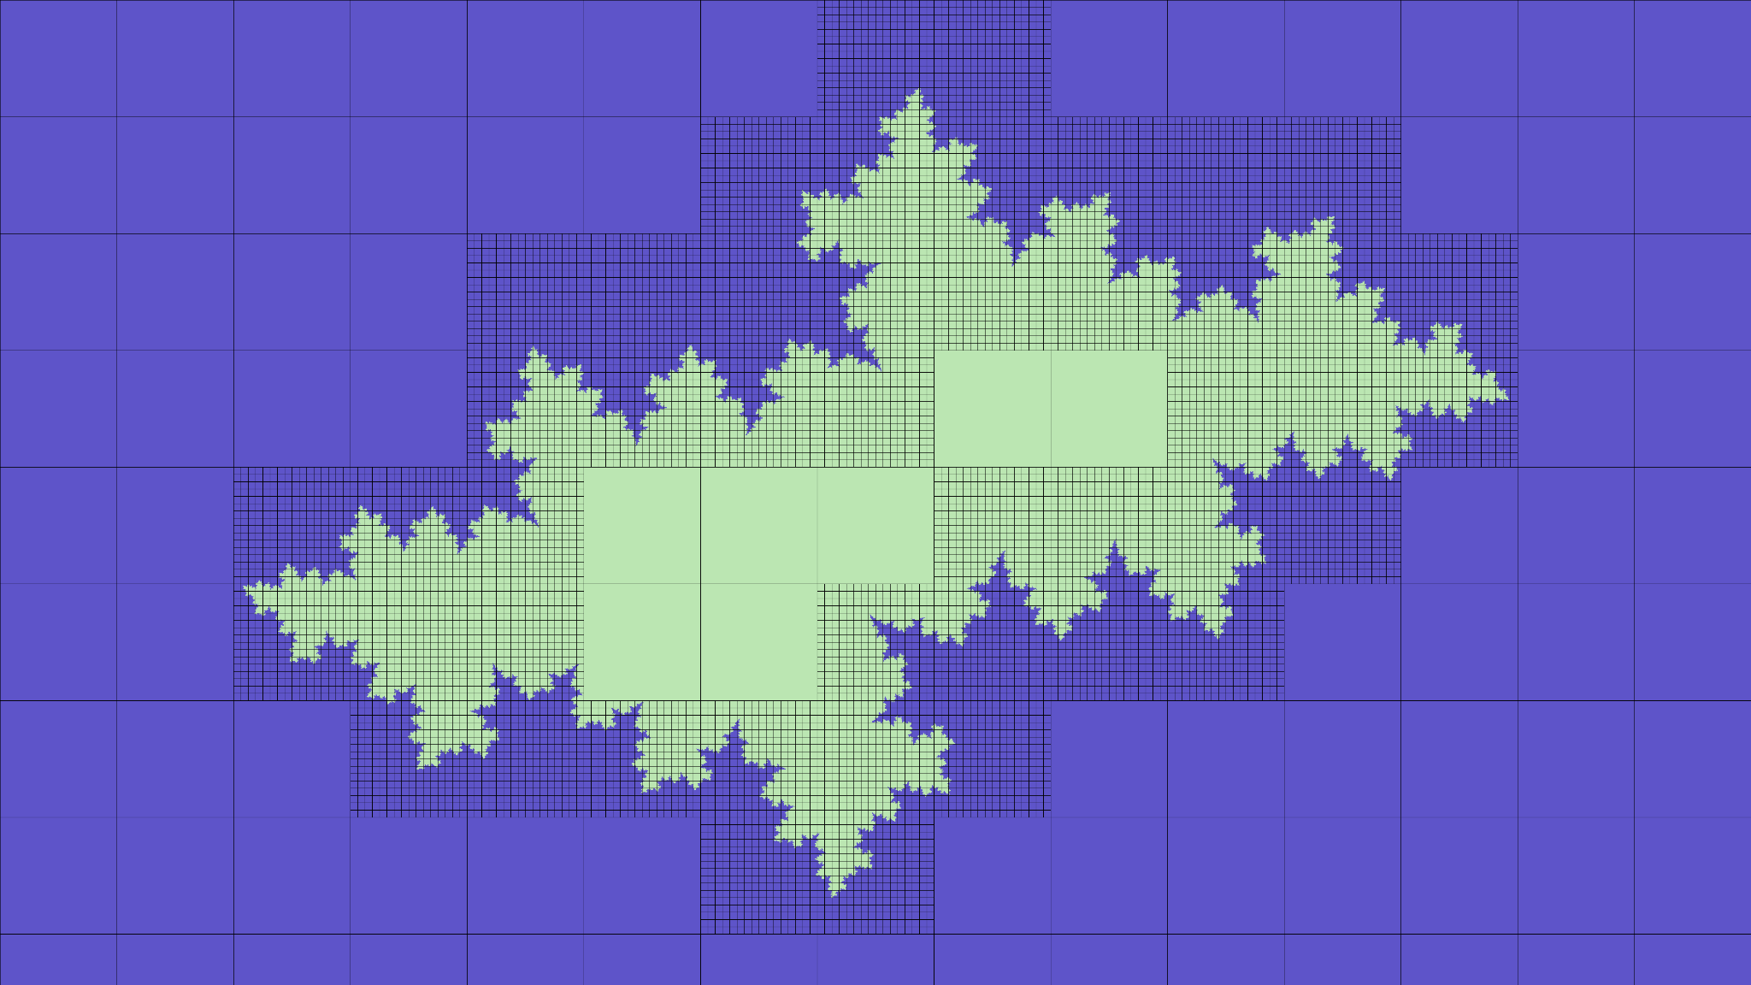
Fractal computation (coarsening)
Some calculation can be avoided by analyzing big blocks of pixels before focusing on smaller ones.
Operations are made using dynamic parallelism.

Slide 6
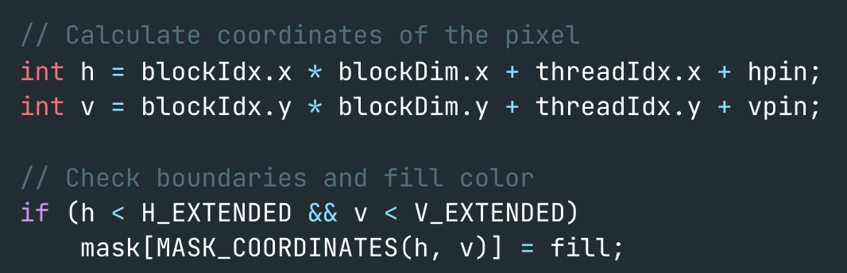
Fractal computation (coarsening)
If the border of a block consists of a single color, it is possible to avoid computing inside pixels, and just fill it.

Slide 7
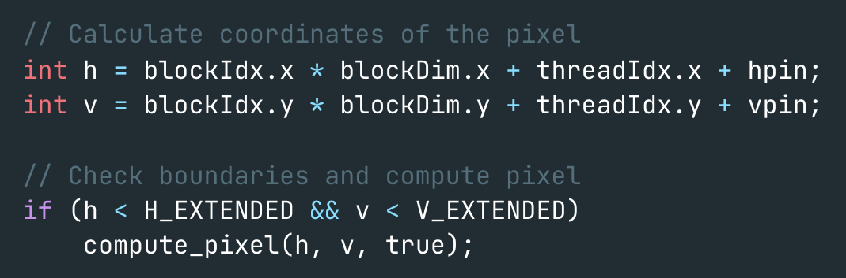
Fractal computation (coarsening)
If the current block reaches a size that is smaller than a certain threshold, each pixel in the block is assigned with a thread.

Slide 8
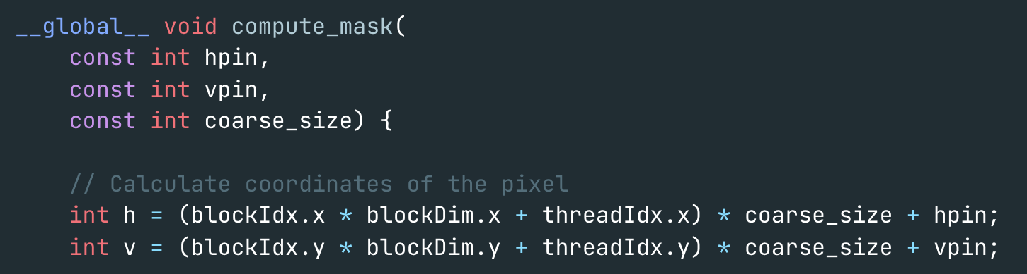
Fractal computation (coarsening)
If the block border isn’t consistent, a recursive kernel call will assign each sub-block a thread.

Slide 9
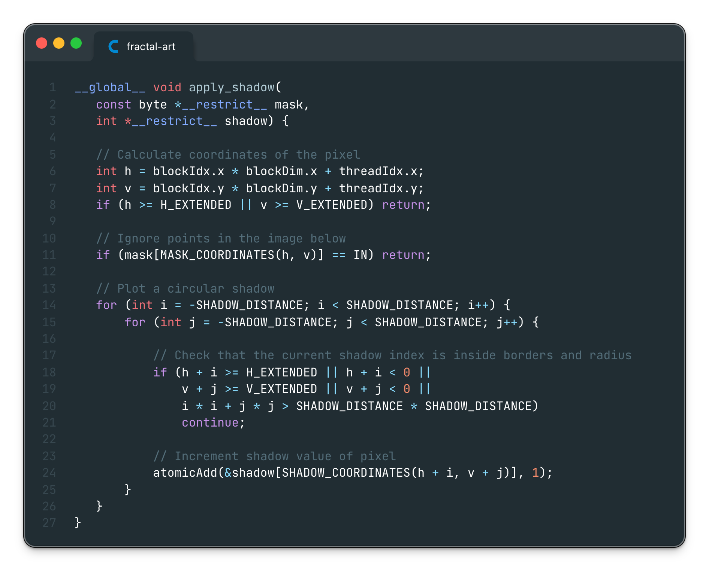
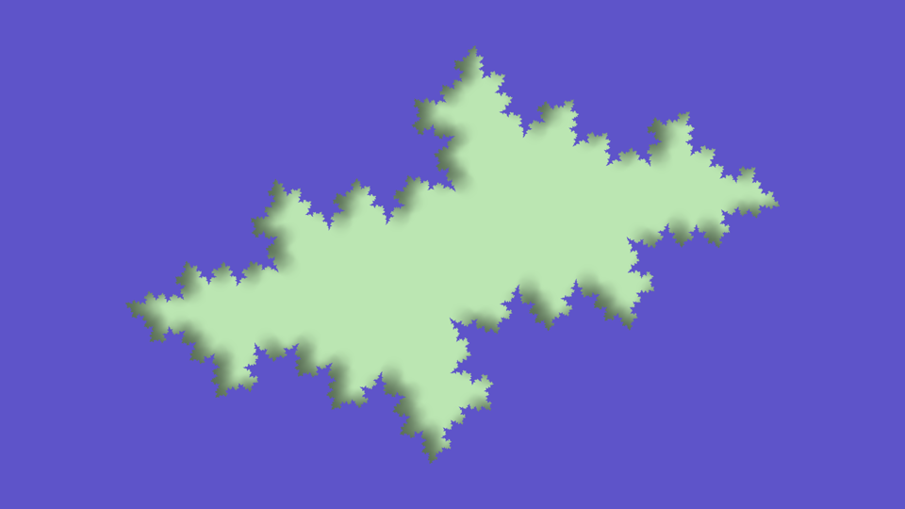
Shadow projection
Mask’s pixels belonging to the above image plot a circular shadow under them.
The more pixels plot a shadow in a point, the darker it gets.

Slide 10
Shadow projection
Pixel coordinates calculations are based on the global thread ID (excluding outbounds and behind image pixels).

Slide 11
Shadow projection
Each thread adds its own contributions for the shadow intensity in the shadow matrix, for each point in the circle.

Slide 12
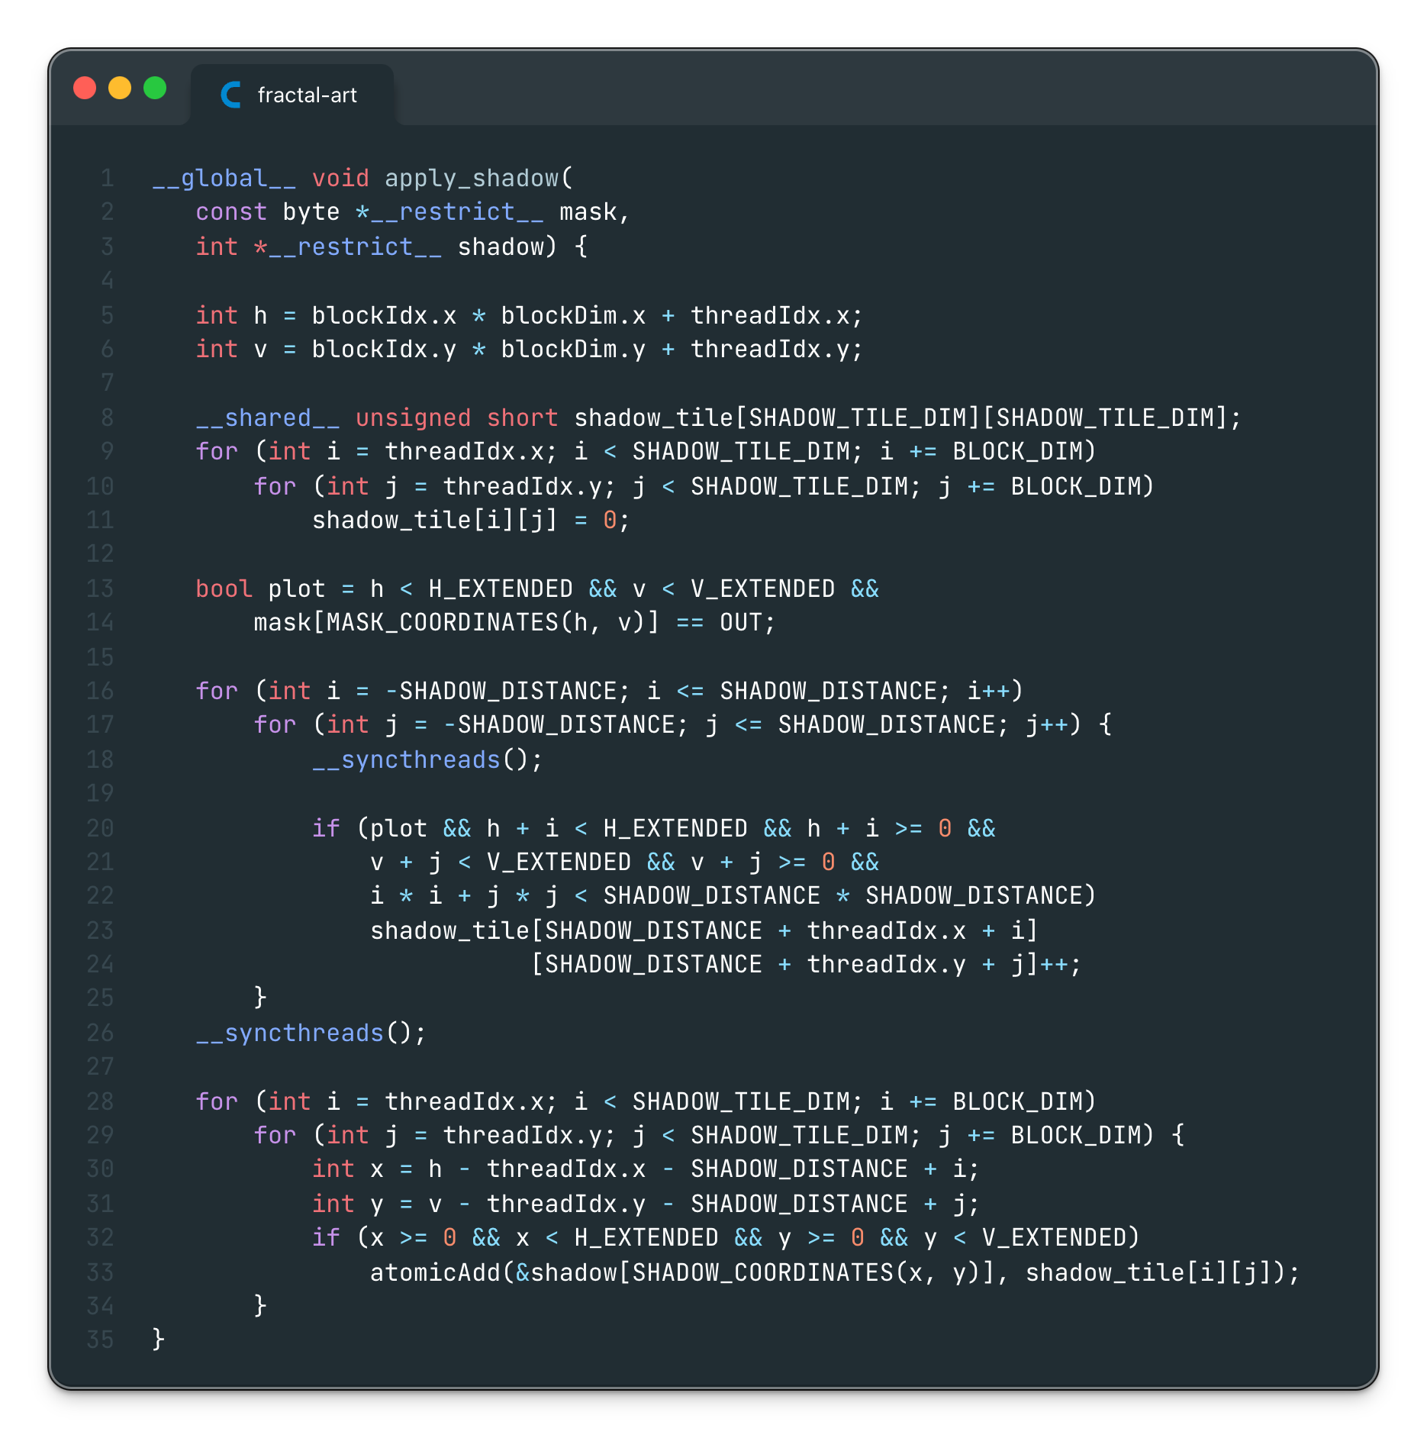
Shadow projection (tiling)
A shared matrix is used by each block to compute the shadow contribution of its threads independently.

Slide 13
Shadow projection (tiling)
Shadow projection made by each thread is now done on shared memory and without the need of atomic additions.
Outbound threads and behind image pixels are excluded.

Slide 14
Shadow projection (tiling)
Finally, values in the shared tile are put back into global memory.

Slide 15
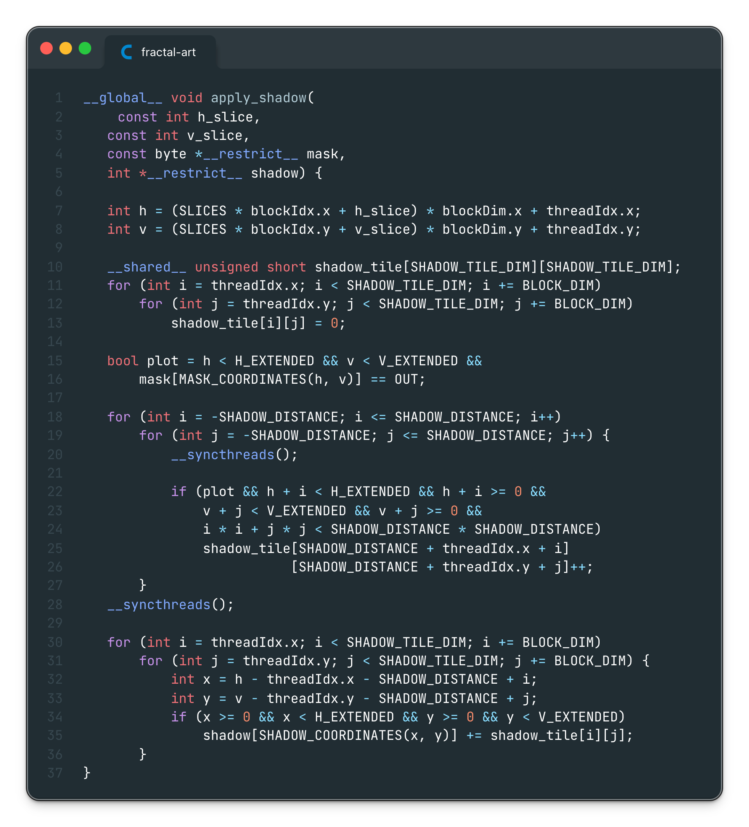
Shadow projection (slicing)
Furthermore, execution can be performed by smaller isolated kernels, to avoid atomic additions when transferring values from the shared tile to global memory.

Slide 16
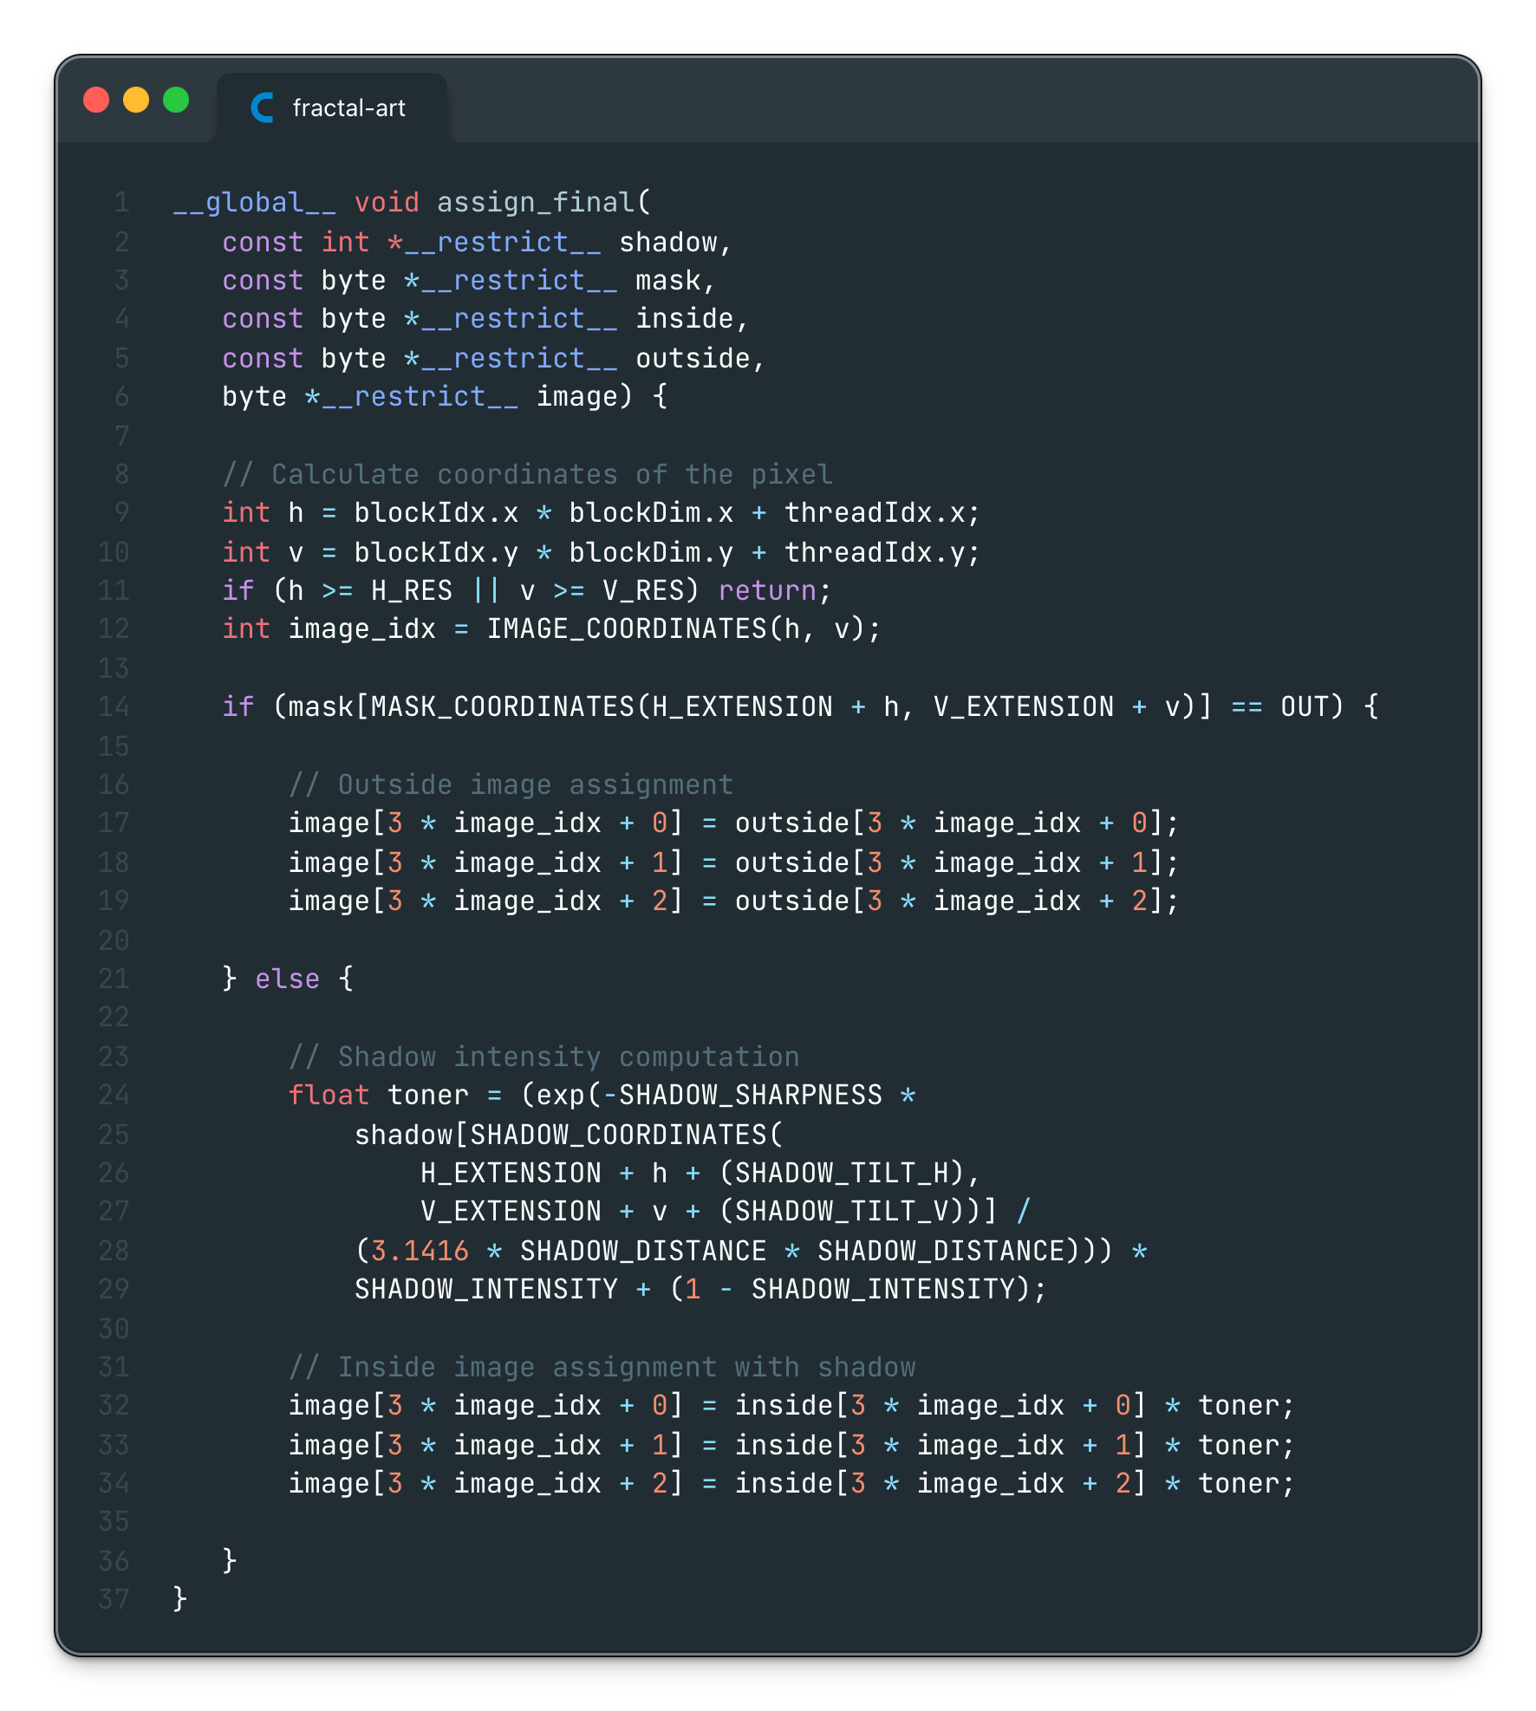
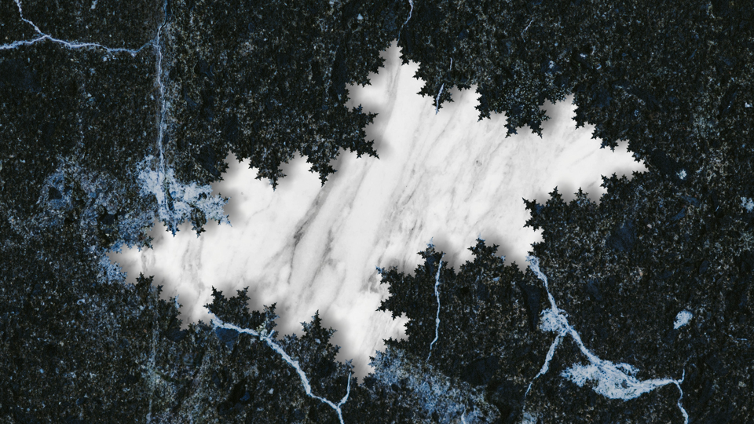
Texture application
In the end, the mask is used to decide which input image is to be applied as texture on every pixel.
The shadow matrix tells the darkness of the pixel.

Slide 17
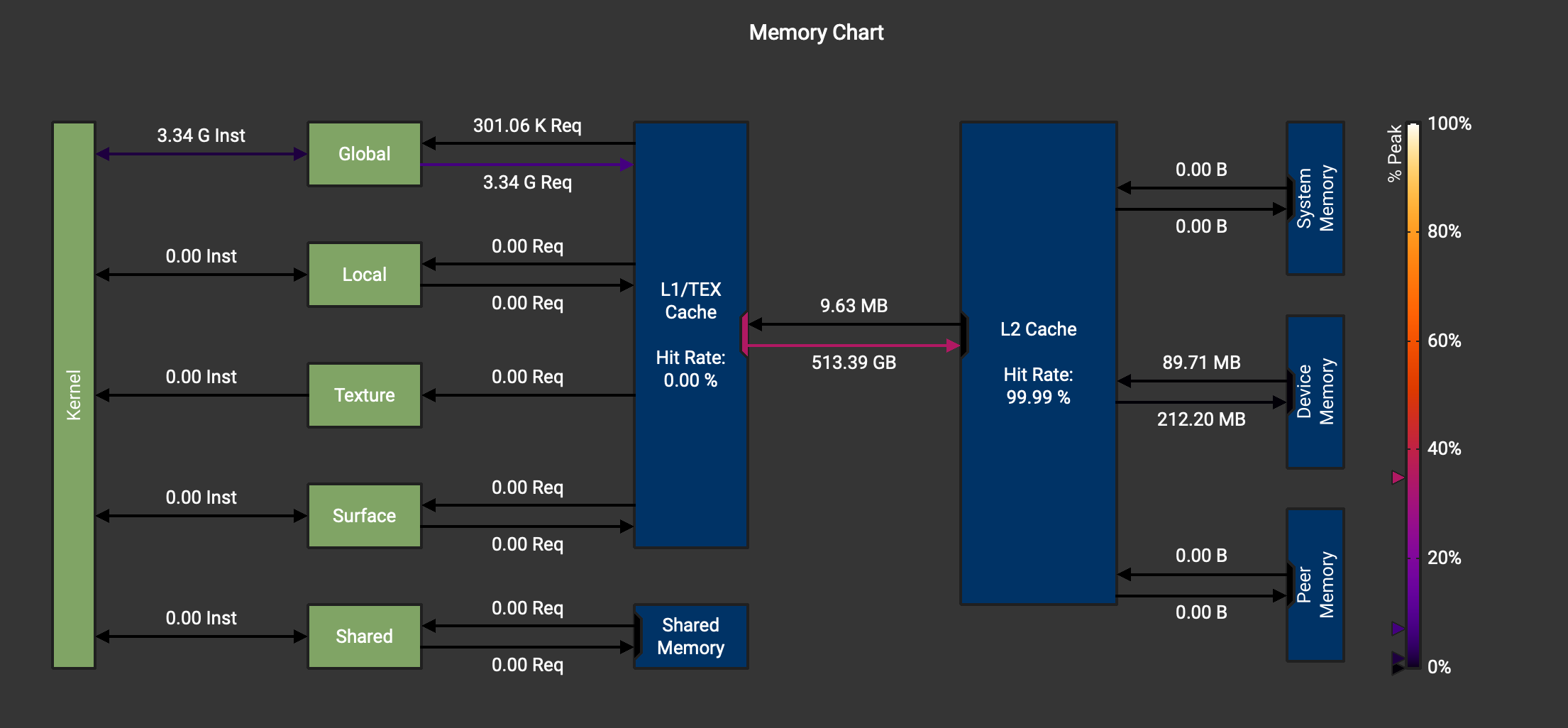
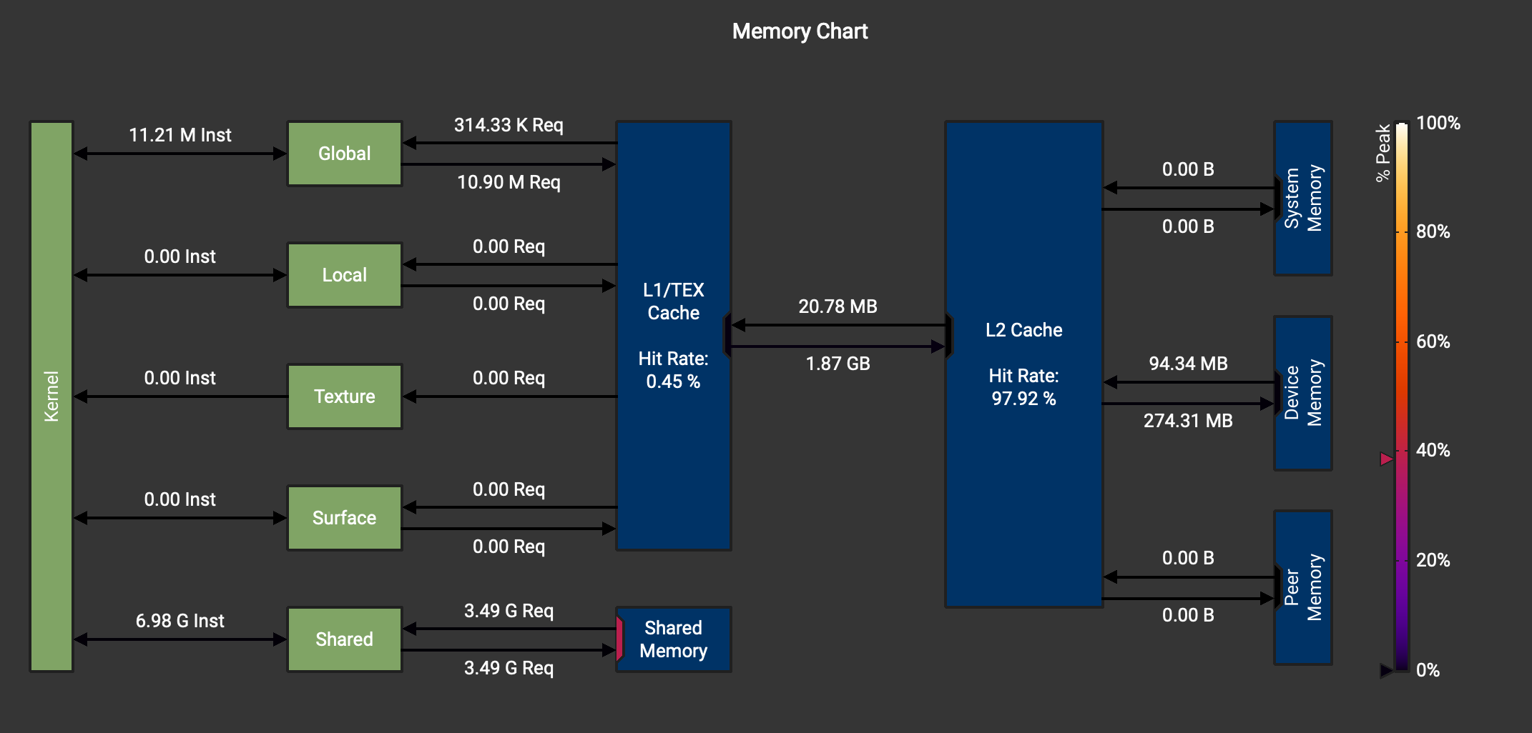
apply_shadow kernel
We implemented the usage of shared memory to reduce memory accesses.
Naive version
In the tiling version we have many requests for the shared memory, providing an optimization step.
Tiling version

Slide 18
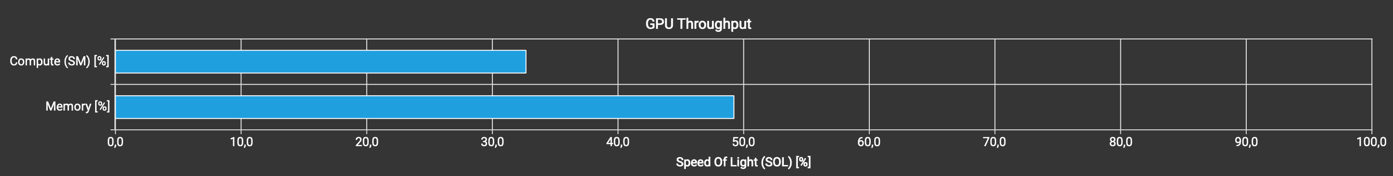
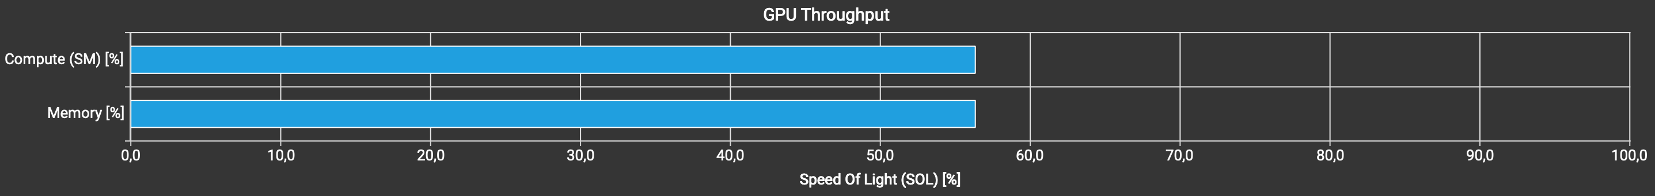
apply_shadow kernel (cont.)
Naive version
Tiling version
Also, we achieved better performances w.r.t. the overall GPU throughput.

Slide 19
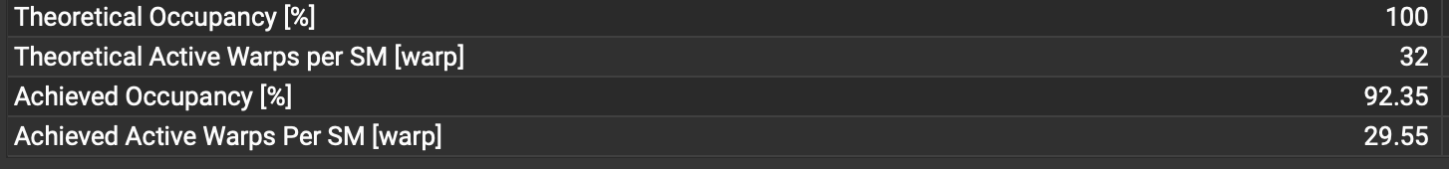
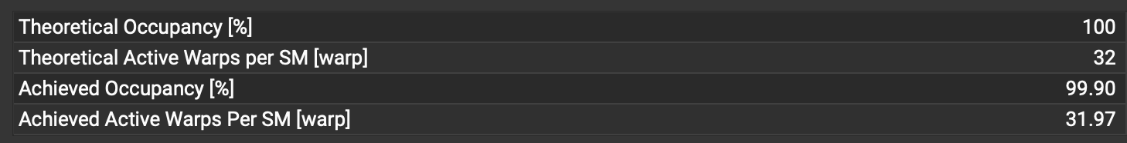
apply_shadow kernel (cont.)
Naive version
Tiling version
The achieved warp occupancy got better, along with active warps per SM.

Slide 20
apply_shadow kernel (cont.)
Slicing version
Tiling version

Slide 21
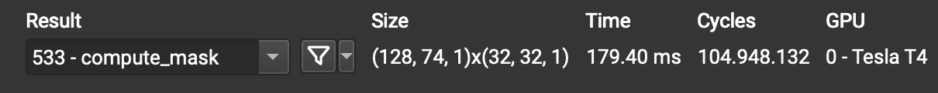
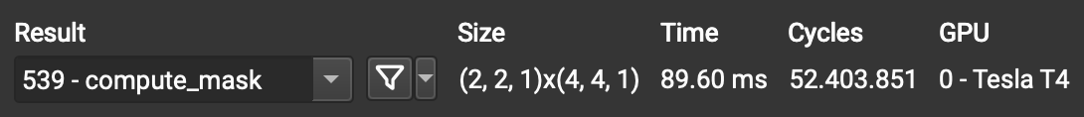
compute_mask kernel
By implementing a thread coarsening version of the code, we also made possible the halving of the compute_mask kernel duration.
Naive version
Coarsening version

